Slide 1


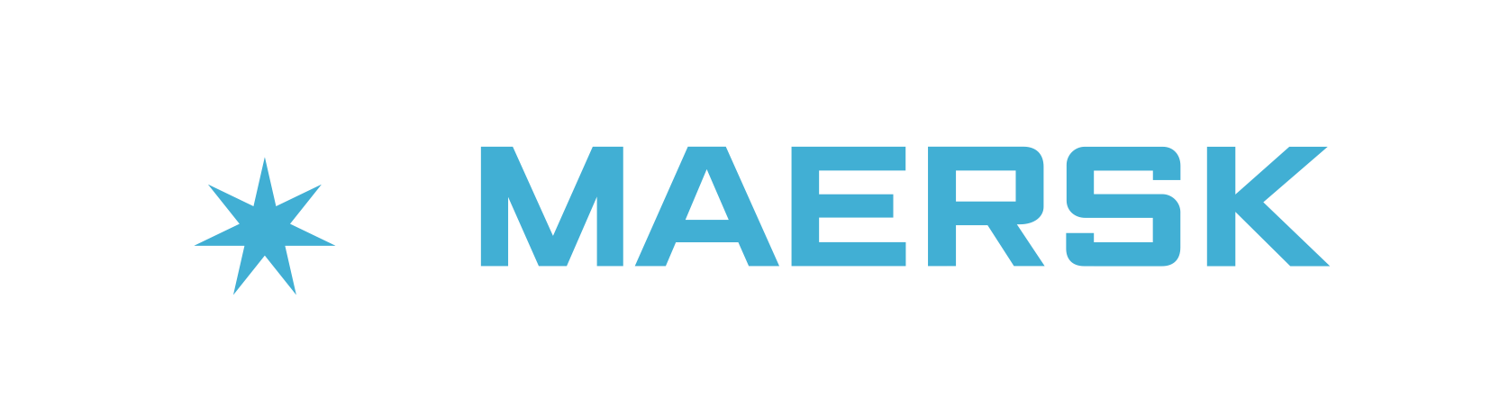
Building a Unified Delivery Model By Rasmus Hald Head of CCoE Twitter: @RasmusHaldDK
Notes:
Welcome
Thank for tuning in

Slide 2


Agenda
Short introduction to Maersk
History of DevOps at Maersk
Developing a Unified Delivery Model
Operationalizing the Unified Delivery Model
Using LEAN to drive the conversation
Driving awareness through assurance
Final thoughts
Notes:
Maersk is in the middle of an overall digital transformation that has a huge impact on how the enterprise views value and brings it to market. As part of this transformation we have realized that the biggest constraint in getting value to market faster is our own organization. We are changing that with DevOps. Join us for a talk about how you can leverage LEAN practices and DevOps practices to accelerate the creation of new innovative digital solutions to create new business value streams.

Slide 3
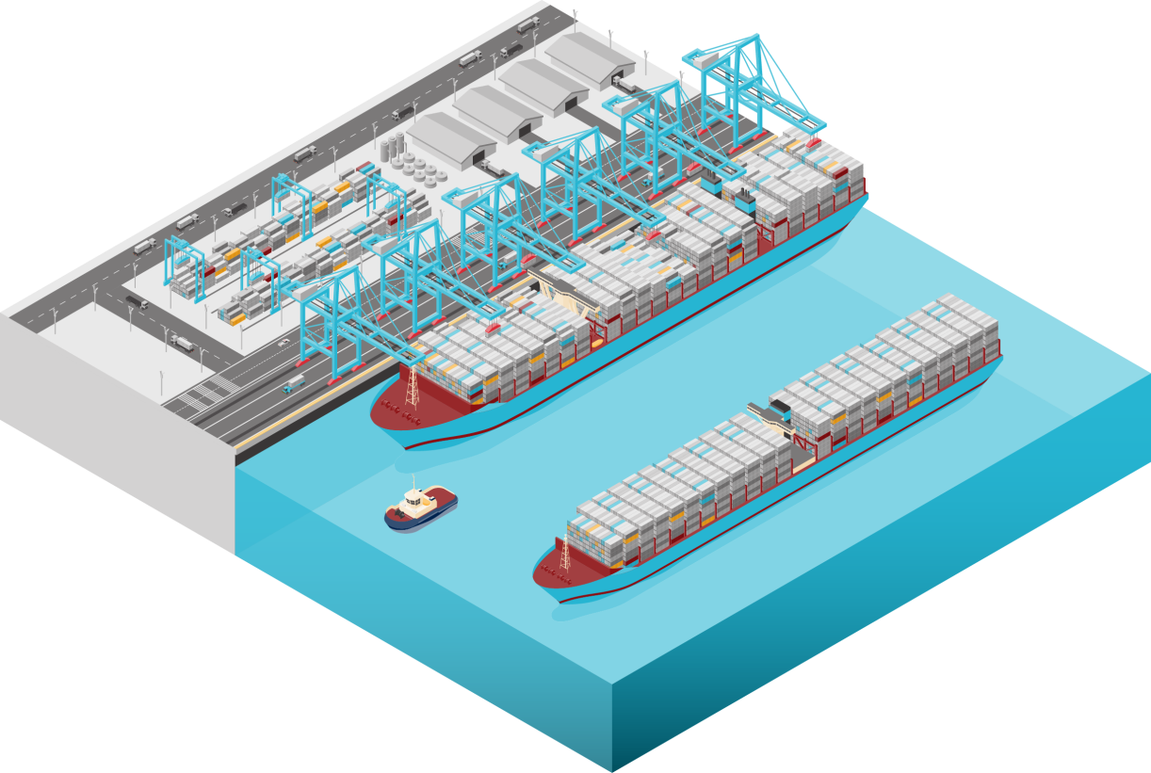

Introduction to MAERSK Global Integrator of container logistics
MAERSK L&S
APM TERMINALS
MAERSK CONTAINER INDUSTRY
MAERSK LINE
SVITZER
Notes:
Talking points
Asset heavy enterprise
750 vessels, Terminals, Tugboats etc
44K employees

Slide 4
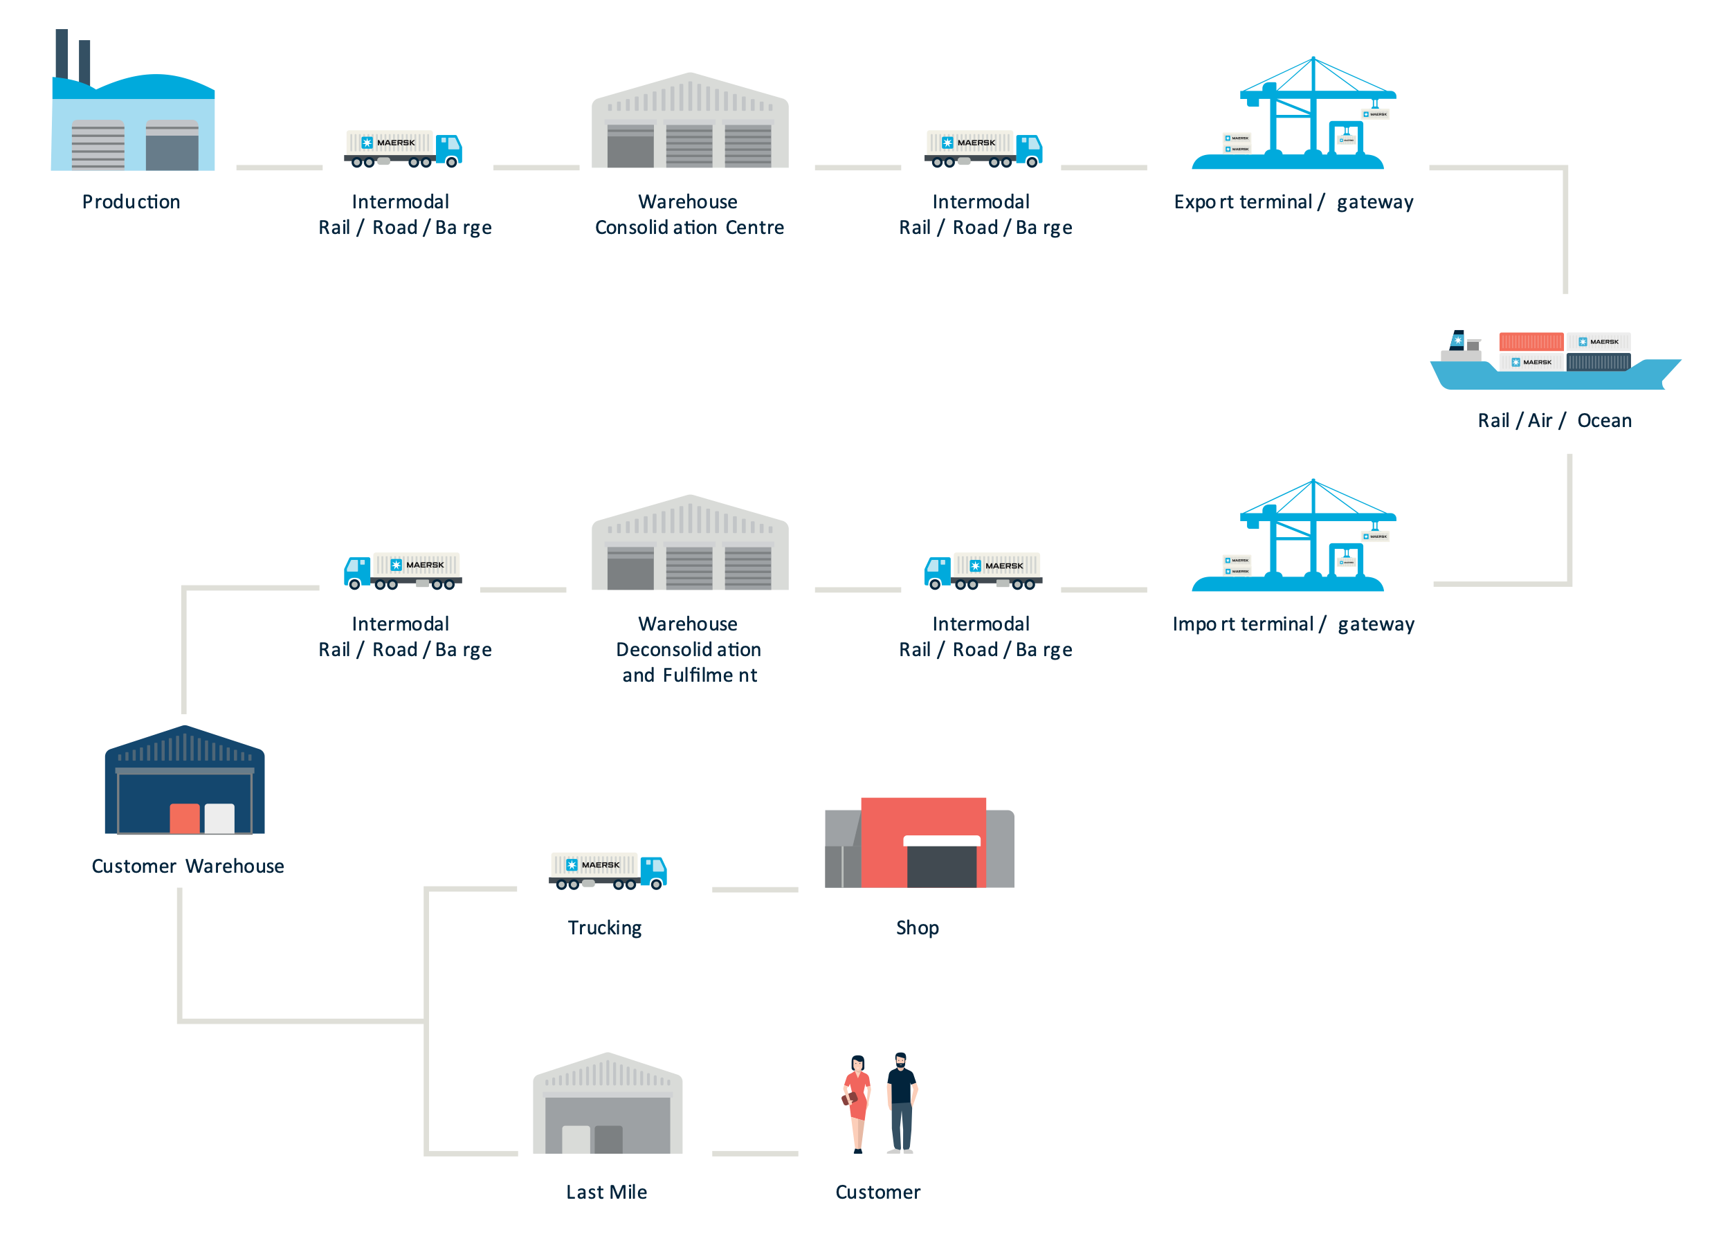
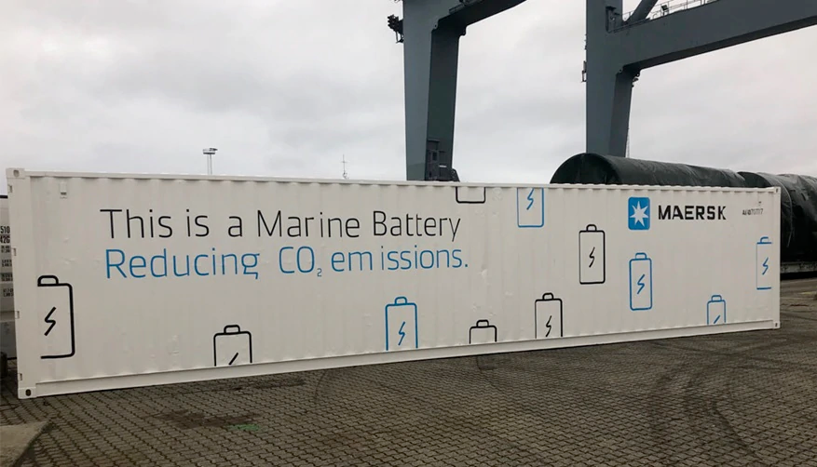
Introduction to MAERSK Global Integrator of container logistics
Simplifying the Supply Chain
Driving Carbon-free logistics
Notes:
Talking points
Integrator vision
Becoming our customers supply chain by building integrated supply chain management solutions
Our Tradelence solution uses Blockchain for zero-trust document exchange between actors in the market
Sustainability
Using technology to bring down fuel consumption
Example is our Marine Batteries, where we use technology to understand how we become energy efficient

Slide 5

History of DevOps at MAERSK It all started in the shadows….
Unified Delivery Model inception
2017
2019
Strategic
Tolerated
Disapprove
Before
Bimodal-IT
Post Bimodal-IT
DevOps Delivery
Waterfall Delivery
Notes:
Talking points
Before
Standard delivery would be ITSM based on Waterfall. Average lead time to production was about 24 months
DevOps was going on in the shadows but not at scale
Nobody talked about DevOps – Was frowned upon.
Bimodal
Accepted shadow IT
DevOps using Start-up mentality.
Created a divide between engineers - Mode1 vs. Mode 2
Did not leverage enterprise capabilities
About a 35 products launched using DevOps
In general deliveries takes 18M
Was still hard to get access to data
Post Bimodal
About a 100 products launched using DevOps
Most of them does not use central capabilities
A need to Unite the Engineering communities
DevOps was and still are engineering driven

Slide 6
Developing the Unified Delivery Model Using the Agile retrospective
Divide between engineering teams
Little or
no re-use
No use of Enterprise Capabilities
Lack of Security oversight
Hard to scale innovation
Notes:
On one side we have Classic IT with concerns and requirements
The other side are developers that are looking for autonomy

Slide 7
Advantages of Enterprise DevOps Aligned autonomy
Finding the balance of aligned autonomy
 | Enterprise DevOps | Start-up DevOps | Functional Enterprise
Ways of working: |  | Agile | Waterfall
Culture: |  | Nimble | Functional
Potential for reuse: |  | Less | Forced
Foundational Capabilities |  | Fewer | Many
Processes (Waste) |  | Few | Many
Autonomy |  | Very high | Low
Notes:
We evaluated on how to strike the right balance of authonomy

Slide 8
Advantages of Enterprise DevOps Aligned autonomy
Finding the balance of aligned autonomy
 | Enterprise DevOps | Start-up DevOps | Functional Enterprise
Ways of working: | Agile | Agile | Waterfall
Culture: | Empowering | Nimble | Functional
Potential for reuse: | Great | Less | Forced
Foundational Capabilities | Many | Fewer | Many
Processes (Waste) | Automation | Few | Many
Autonomy | Aligned | Very high | Low
Notes:
And agreed that aligned authonomy would get us a long way

Slide 9


Introduction to the Unified Delivery Model A common and agreed way for cloud-based delivery
DevOps
Continuous Delivery
Classic
Support for dedicated product teams that are capable of building and running production services.
Support for agile teams doing Continuous Delivery with hand-over to IT Operations.
Classic service offering for business-critical services needing an SLA.
Investment
Requirements
Development
Test
QA
Service Trans.
Release
Operations
Support
UDM – Classic
UDM – Continuous Delivery
UDM – DevOps
Business Outcomes
Idea
Value
Notes:
Introduce UDM

Slide 10
Step 2 – Get leadership support Leveraging the strengths of Enterprise IT
DevOps
Continuous Delivery
Classic
Support for dedicated product teams that are capable of building and running production services.
Support for agile teams doing Continuous Delivery with hand-over to IT Operations.
Classic service offering for business-critical services needing an SLA.
Shared Self-service capabilities
Security Operations Center
Service Desk
Cloud Management
Centralized SecOps team that manages security events 24/7
End-user facing single point of contact service desk that creates tickets for downstream teams
Central Cloud Management platform to allow self-service environment provisioning
Command & Control
DevOps Toolchain
Infrastructure as Code
Centralized team that manages enterprise-wide incidents and acts as a command hub.
Hosted DevOps toolchains to allow rapid deployments and reuse across teams
Inner sourced Infrastructure as code repository to allow re-use of environment build.
Notes:
Step 2 – Get leadership support
Minimal Viable Technical requirements that everyone could support (Leadership & Engineering teams)
Importance of Leadership support

Slide 11
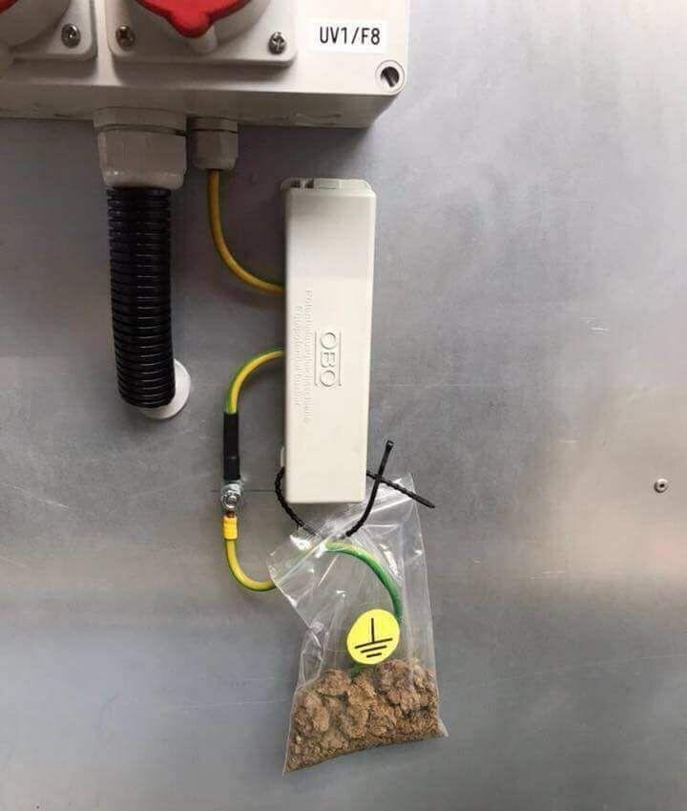
Operationalizing the Unified Delivery Model Moving from concept to reality at scale
My easy* guide to DevOps:
Step 1 – Agree on pain points and opportunities
Step 2 – Drive awareness
Step 3 – Start over again….
* There is nothing easy about it, but it´s fun
Notes:
At this time we had a powerpoint that explainer how we should work
Operationalizing it is really hard
So what we did was….

Slide 12
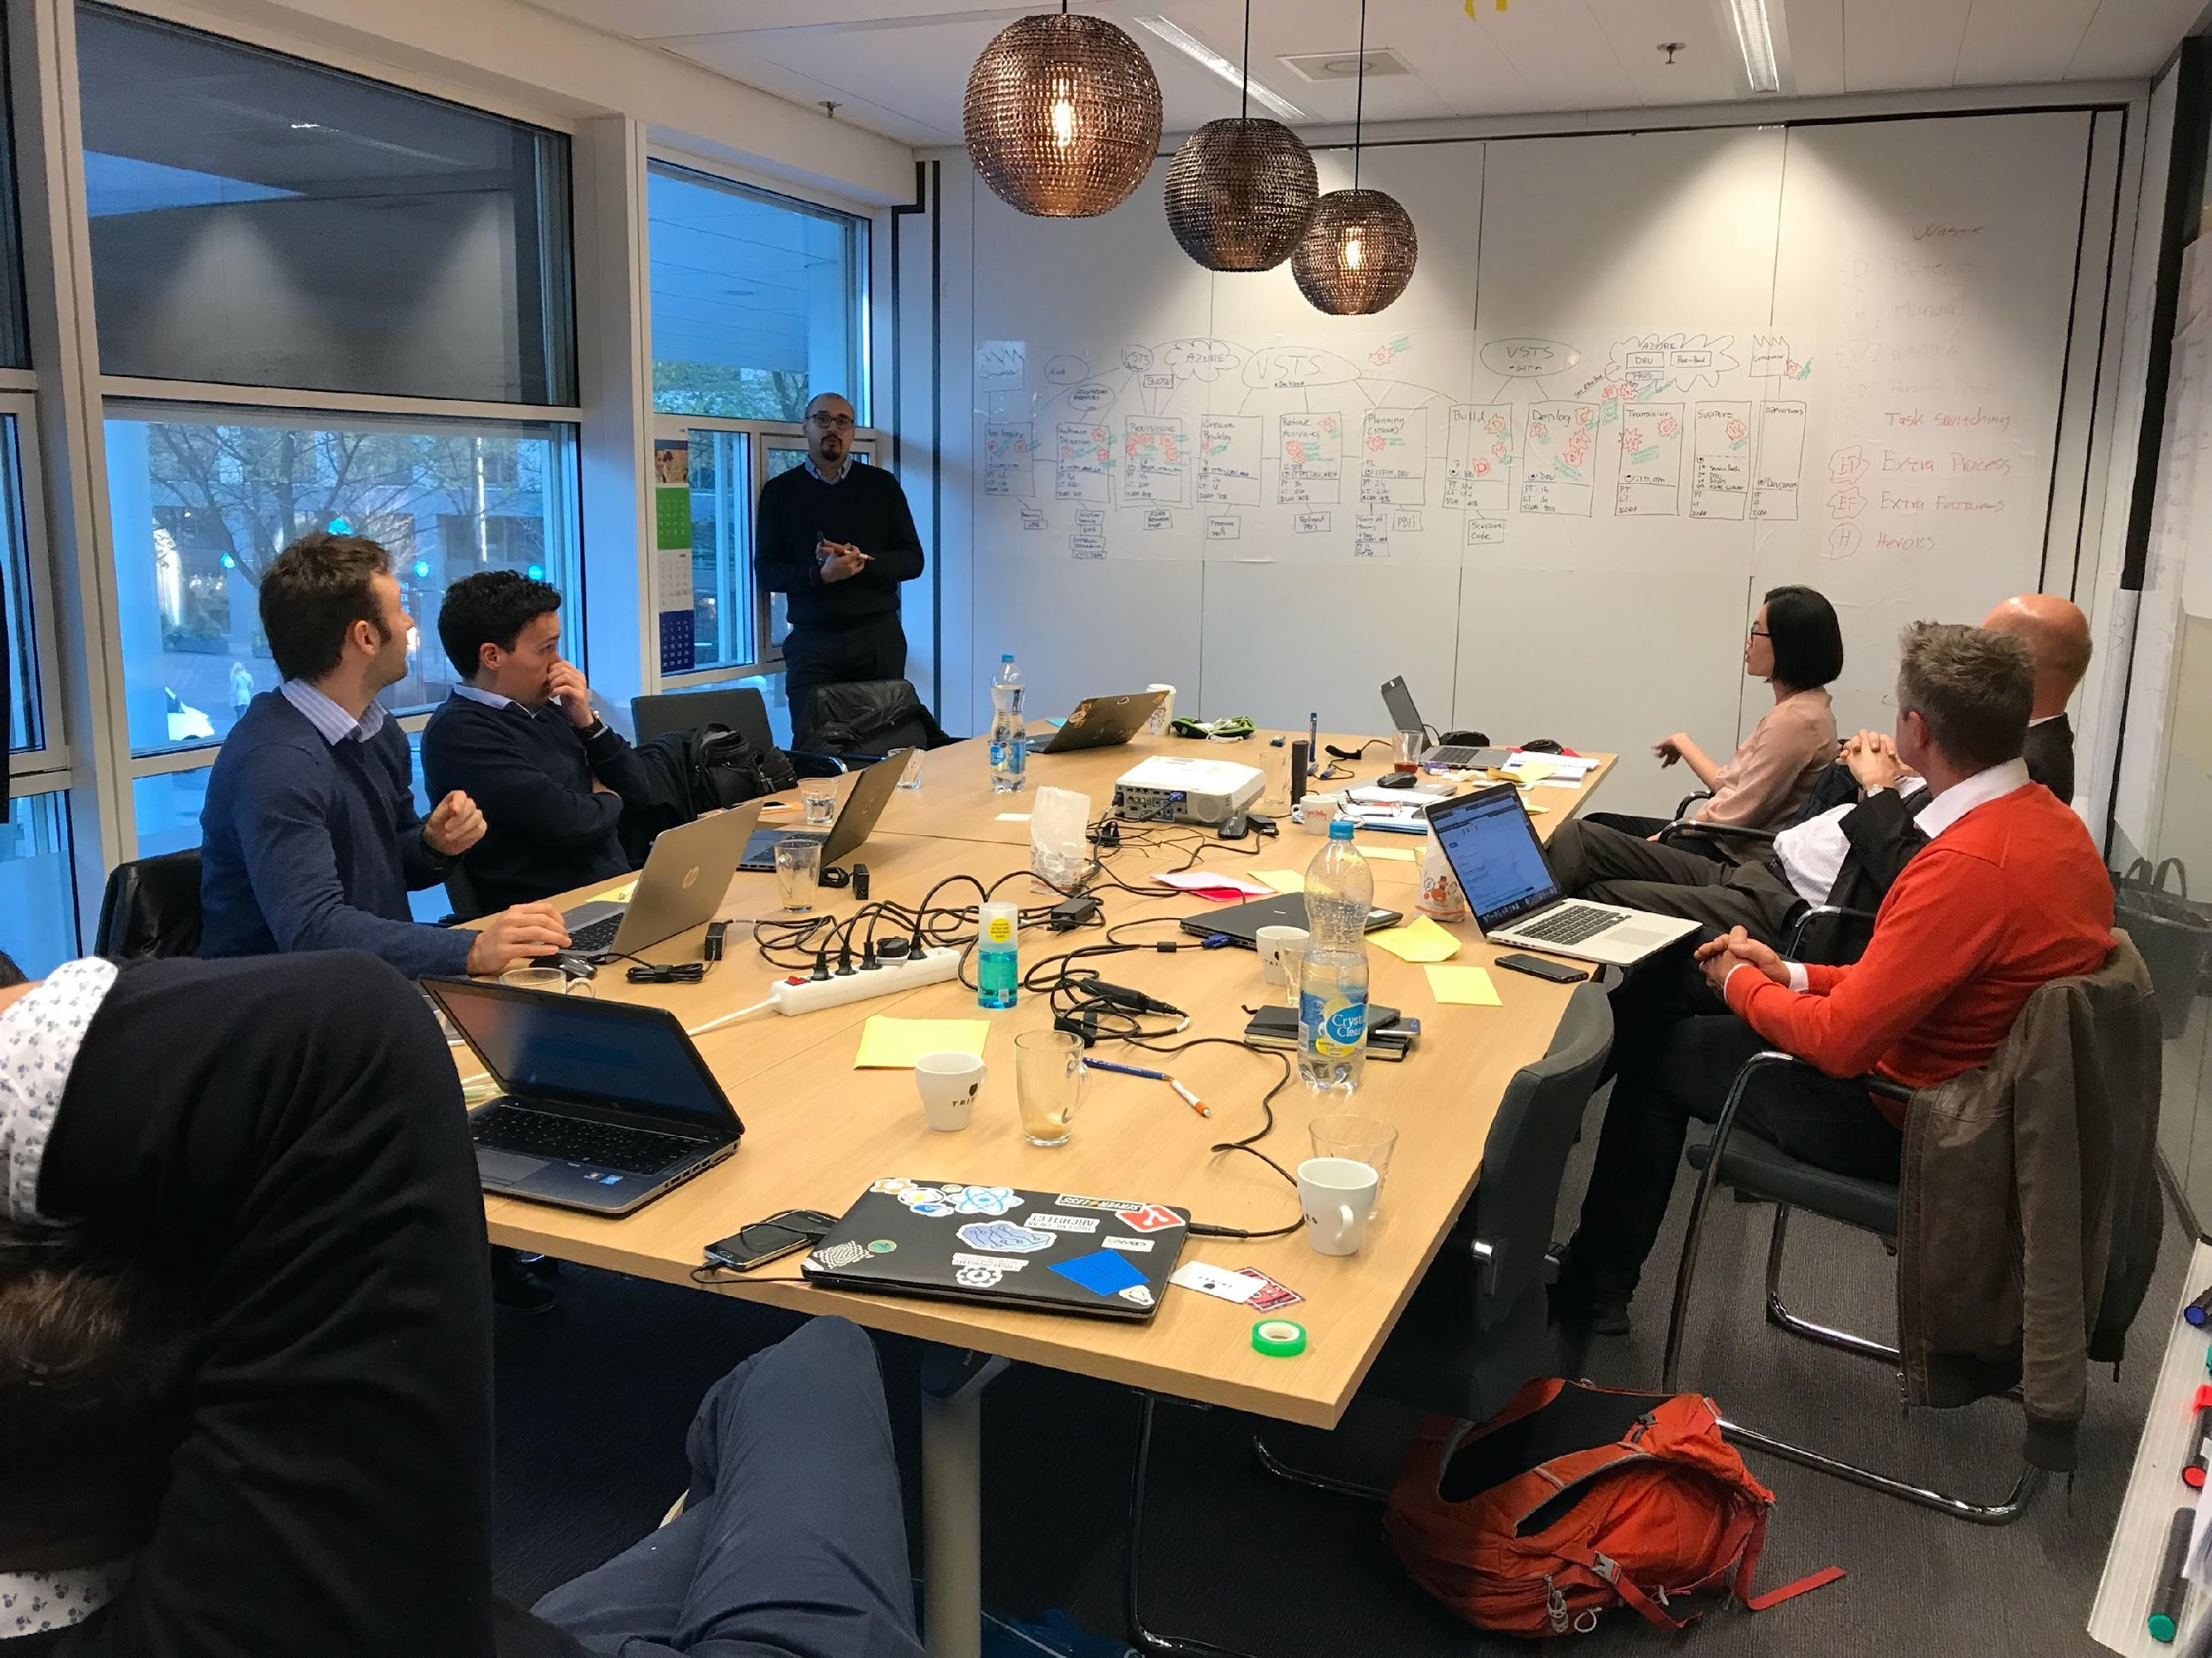
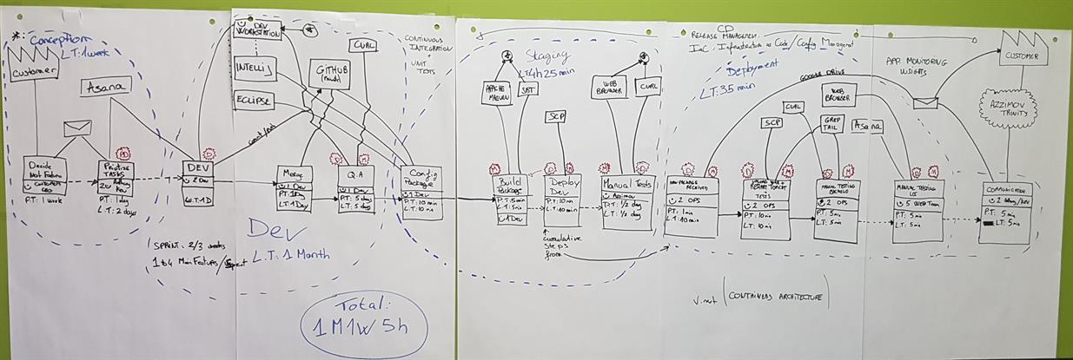
Step 1 – Agree on pain points and opportunities Using the LEAN toolbox
End-to-end Value Stream Mapping
Visualize flow of value
Analyse waste (of time)
Optimize digital delivery
Notes:
Expain VSM
Macro level mapping
With stakeholders
Looking to learn how we work
And identify opportunities to reduce waste
What we learned:
It took about 24 months to release a new digital product
To shortcut the 24 months most deliveries did not implement IT capabilities
Centralized IT had no visibility and DevOps delivered products
We had very poor reuse of even basic capabilities

Slide 13
Step 2 – Drive awareness Establishing an assurance framework
Introducing UDM Beacons
A visualization of the journey to production
Each beacon represents a risk mitigation.
When the beacon is green, it is safe to continue the journey
When the beacon turns red, it is riskful to continue.
Notes:
Waterfall has gates … We have beacons to guide the DevOps Teams home
Turning the problems upside down
Gates become guides
Capabilities becomes DevOps friendly with automation and self service
What sound does the tree makes when it falls?
This was a harder task – Not much is described on how to operationalize DevOps in an Enterprise
Gamification

Slide 14
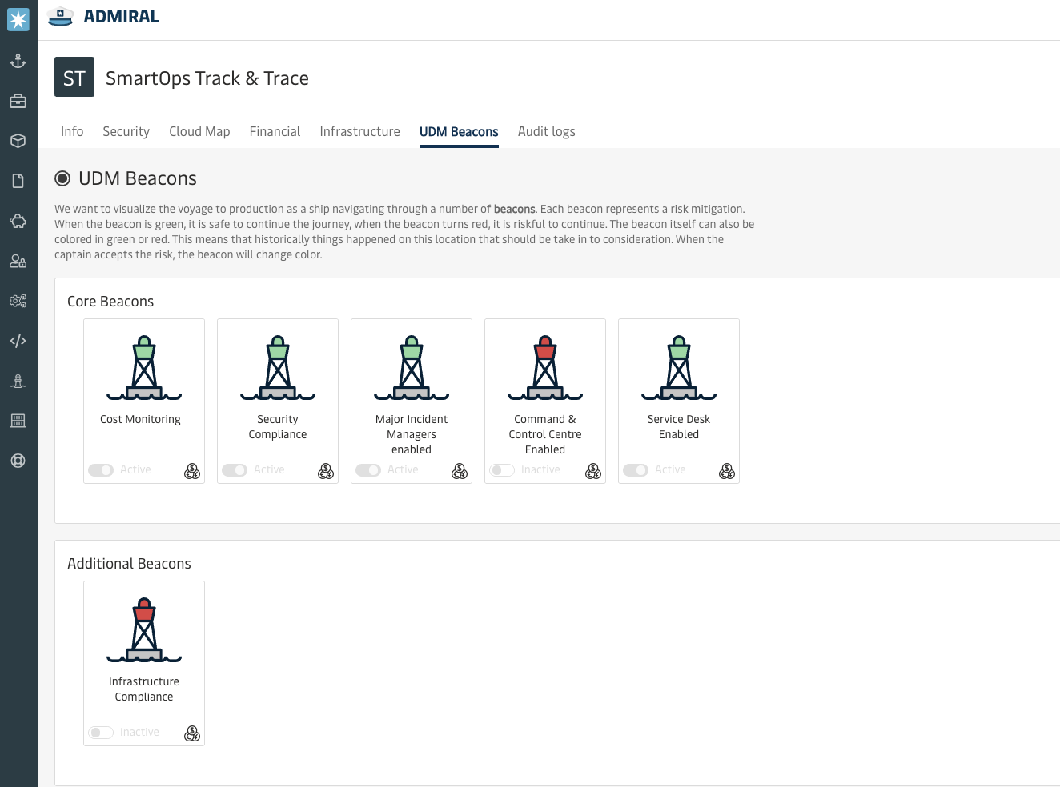
Demo: UDM Beacons Product view

Slide 15
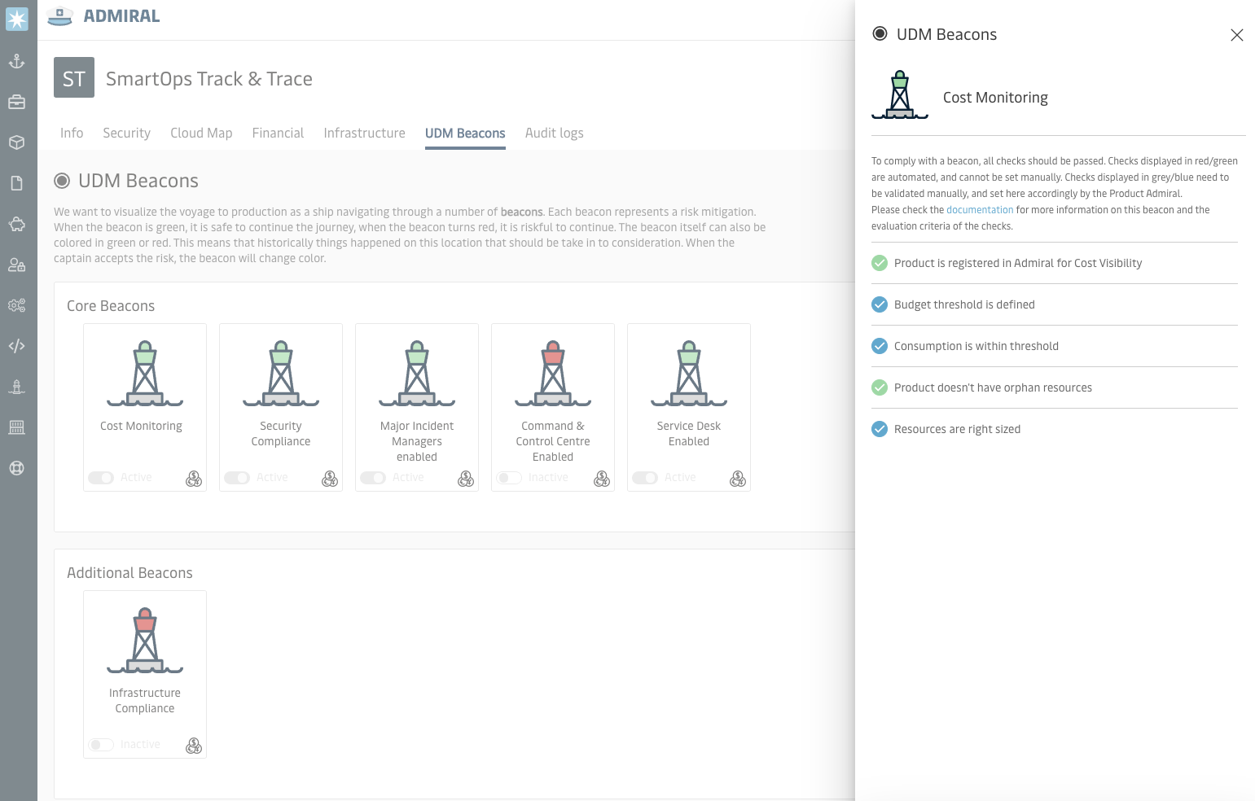
Demo: UDM Beacons Product view

Slide 16
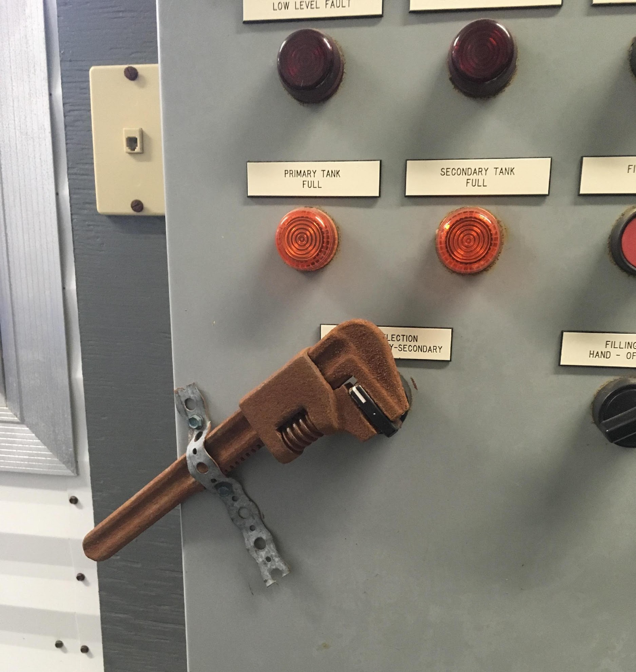
Step 3 – Start over again…. Continuous Improvement
February 2020, we kicked off our second round of VSM
New group
Engineering led
Focus on Developer Productivity
Notes:
First round was very IT focused, second round was engineering productivity.
Cross team, cross functions
Everybody wants a beacon
First we got a new CIO
Then we got a pandemic
A timeout was taken
Moving beyond:
We found new tools –
We did our first online VSM session

Slide 17

Conclusion Digital Delivery – A journey to production
Our learnings:
Agree early on central capabilities and requirements
Focus on engineering productivity
Use LEAN to drive the conversation
Establish an assurance framework to drive visibility
Notes:
Our learnings:
Agree early on central capabilities and requirements
Focus on engineering productivity
Use LEAN to drive the conversation
Establish an assurance framework to drive visibility
We spend a lot of effort on articulating policies however they were never agreed
We built it and they came
What's next:
End-to-end development process
New CIO, new operating model
UDM for everything

Slide 18
Conclusion Digital Delivery – A journey to production
What's next:
End-to-end development process
New CIO, new operating model
UDM for everything - How do we scale the efforts
Notes:
What's next:
End-to-end development process
New CIO, new operating model
UDM for everything

Slide 19
Building a Unified Delivery Model By Rasmus Hald Head of CCoE Twitter: @RasmusHaldDK

